Slide 1
Hormones in humans
What is a Hormone?
What do hormones do?
In groups of 2
Write down your ideas to answer the question
Stand up when you are ready to share with your group
As a group decide on 1 answer for the whole group
Sit down when ready
EVERYONE MUST BE READY TO ANSWER!
Can you think of any examples?

Slide 2
Chemical Messengers
Coordinate systems
Oestrogen
What is a Hormone?
What do hormones do?
Insulin
Glucagon
Testosterone
Can you think of any examples?
ADH
HGH
Travel in the blood, secreted by glands
Causes a change in how the body works
Control Growth, blood sugar, sex development, mood, metabolism.

Slide 3
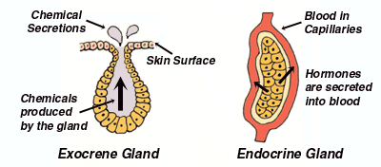
Glands and hormones
Two types of gland – endocrine and exocrine
Exocrine glands have a duct, endocrine glands do not

Slide 4
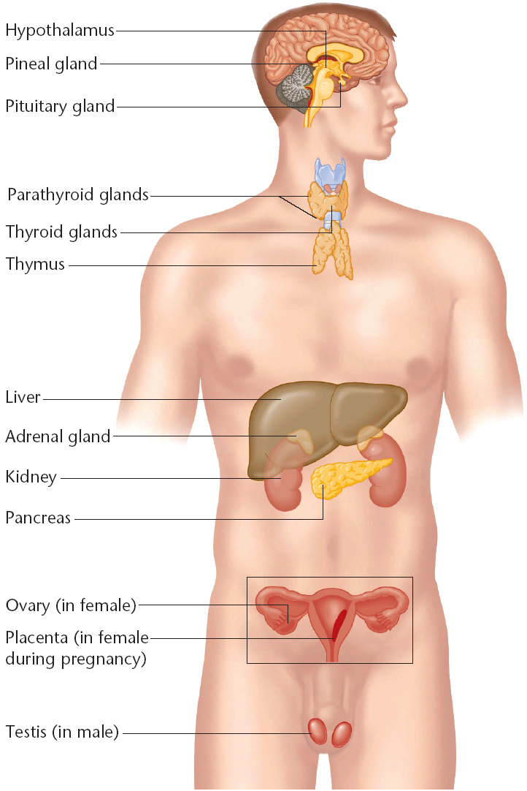
Where are your glands found?

Slide 5
Compare Hormone and Nervous Systems
HORMONES | NERVOUS SYSTEM
Communication is by chemicals called hormones | Communication is by nerve impulses
Transmission is in the blood to all parts of the body. Only target organs respond | Transmission is by neurones and travels to specific parts of the body
Slow Transmission | Fast Transmission
Slow and long-lasting Response | Fast and short-lived response
Response is widespread | Response is localised
Effect maybe permanent and irreversible | Effect is temporary and reversible

Slide 6
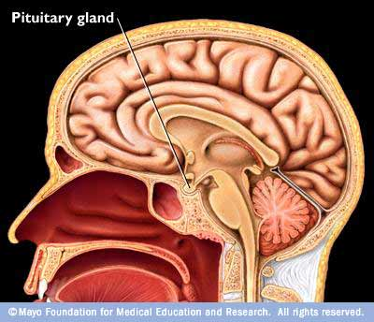
Pituitary Gland
Found at the base of the brain
Produces lots of hormones
Nerves link it to the hypothalamus in the brain

Slide 7
The Pancreas
Both an endocrine and exocrine
Secretes 2 hormones involved in the regulation of blood glucose
And the enzymes into the small intestine.
Which function is endocrine and which is exocrine?

Slide 8
Which hormones do what?
Hormone | Endocrine Gland | Target Organs | Action
Adrenaline | Adrenal Gland | Vital organs e.g. liver and heart | Prepares body for action
ADH | Pituitary Gland | Kidney | Controls blood water level by triggering uptake of water in kidneys
Insulin | Pancreas | Liver and Muscles | Reduces blood glucose level
Glucagon | Pancreas | Liver | Increases glucose level of blood
Oestrogen | Ovaries | Ovaries, uterus, pituitary gland | Controls puberty. Increases the thickness of uterus lining in the menstrual cycle
Testosterone | Testes | Male reproductive organs | Controls puberty in males

Slide 9
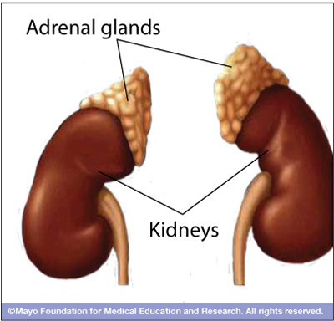
Adrenaline
Complete the phrase:
Fight or flight
Secreted by your adrenal glands

Slide 10
Adrenaline
Think about a time when you were really scared. List what you biological changes you felt.

Slide 11
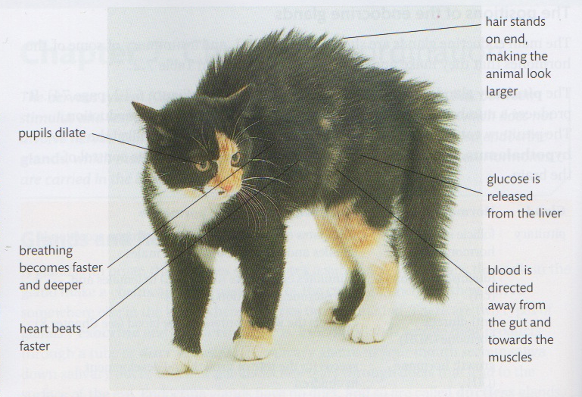
Adrenaline

